Slide 1
SHREE RAMKRISHNA INSTITUTE OF COMPUTER EDUCATION AND APPLIED SCIENCES
Guide:-Mrs.Shweta Bhatia
Presented By:-Nishtha Mukeshbhai Vaghani

Slide 2
CRIME REPORTING SYSTEM

Slide 3
INDEX
Topics covered:
Introduction
Definition
Scope
Objective
Functionality Reqiurement
DFD(Data Flow Diagram)
Flowchart
Database Layout
Screen Layout

Slide 4
Introduction
The Crime Reporting System is an application for reporting the crime and maintaining the crime reports and user details.
The Online Crime Reporting System is an application that covers complete case management system and this project will help in managing all activities of the police stations. It is used to report crimes and manage all the activities in a police station using computers by tracking all the details of complaints,details of complainants, police station, etc

Slide 5
Defintion
Crime Reporting System is an application that covers complete case management system and this project will help in managing all activities of the police station(extended in sem 6)
Client as well as Admin can report the crime(by registering themselves or anonymously) by providing certain details related to the crime report
Admin can manage the reports , complainants , police stations and police officer details
Admin can view the crime details of a particular type of crime and manage accordingly

Slide 6
Objective
Crime Reporting System is devloped with the intent of helping the users who have seen or is the victim of certain crime that is to be reported
It aims in helping the users to get the fastest solution to the crime report(extended in sem 6)
Some important features:
Users can provide the incident details like date,type of crime,etc.
Users can provide the criminal details(if any)so that it will be easier to solve the crime for the police officer
Users can upload the images of the crime scene

Slide 7
Scope
Crime Reporting System is an application that covers complete case management system and this project will help in managing all activities of the police station(extended in sem 6)
It is devloped with the intent of helping the users who have seen or is the victim of certain crime that is to be reported

Slide 8
Functionality Requirement:
There are three entities in the system:
Admin Side
Client/User Side
Police Station and Police Officer Side(extended in sem 6)
Admin Side
Admin login and management of Crime Reports
Management of Complainants Details
Management of Police Stations Details
Management of Police Officer Details
View the Crime Reports according to the type of crime
Client Side
Client login and Registration
Report the crime either by login or anonymously

Slide 9
Admin Module:
Home_page
Admin Login
New Admin Registration
Manage_complaints
Complainants Details
Mange_complainants
Stations Details
Manage_stations
Police Officer Details
Manage_policeofficer Details
View Type of Crime wise Details
Exit

Slide 10
User Module:
Welcome
Client Login
New Client Registration
Report Crime
Extended in sem 6

Slide 11
Functionality
The functionality of each module is as follows:
Admin module:Admin enters the crime and manages the details of the same,Enters user details and manages the same,will be able to enter the station details and policeofficer details and manage the same.
User Module:User will register and login in to the system and report the crime.
Police Stion Module:Police station will be able to view the crime details and take action accordingly and update the status of action.(extended in sem 6)

Slide 12
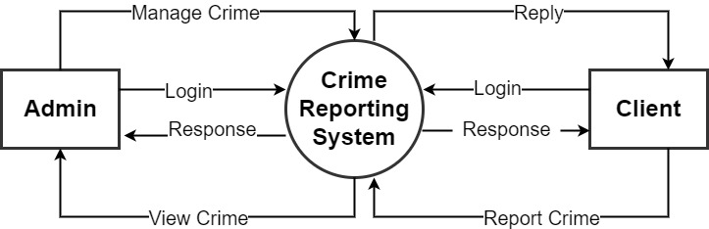
DFD(Data Flow Diagram) Admin side
Zero level DFD

Slide 13
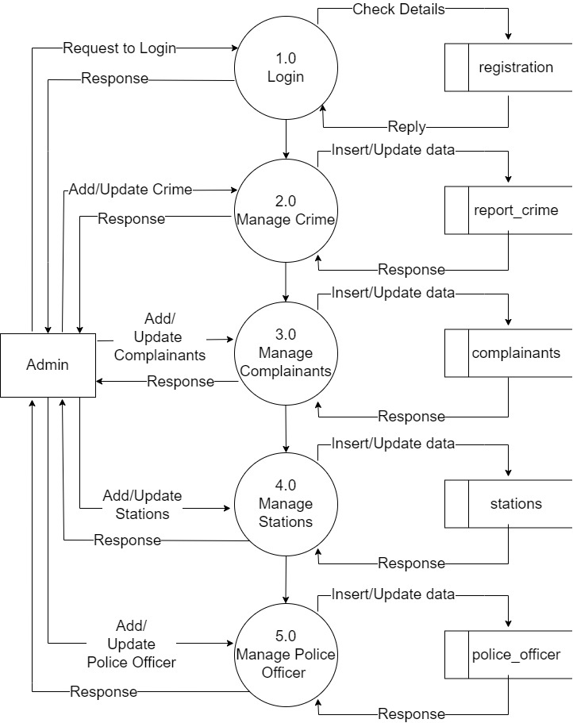
DFD(Data Flow Diagram) Admin side
Level 1 DFD

Slide 14
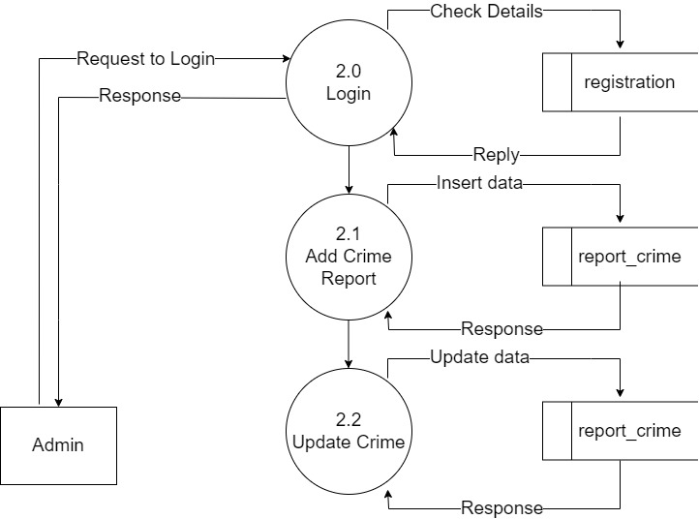
DFD(Data Flow Diagram) Admin side
Level 2 DFD(Process 2.0)

Slide 15
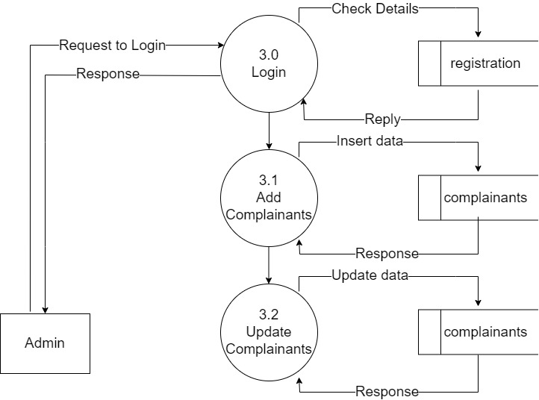
DFD(Data Flow Diagram) Admin side
Level 2 DFD(Process 3.0)

Slide 16
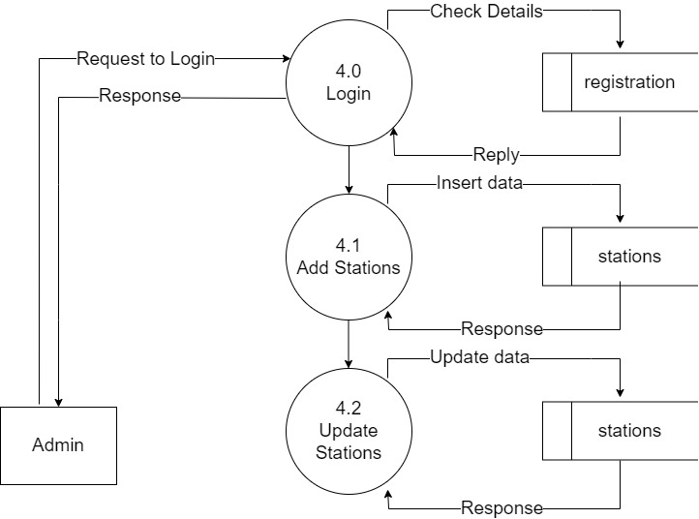
DFD(Data Flow Diagram) Admin side
Level 2 DFD(Process 4.0)

Slide 17
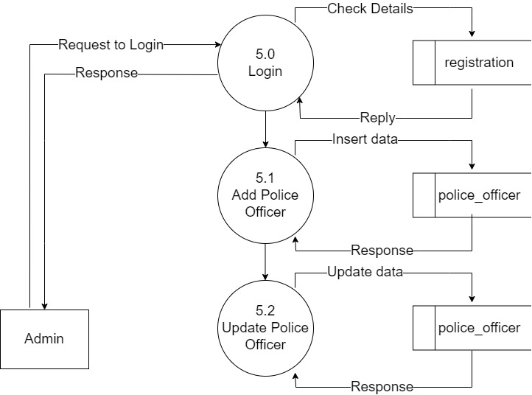
DFD(Data Flow Diagram) Admin side
Level 2 DFD(Process 5.0)

Slide 18
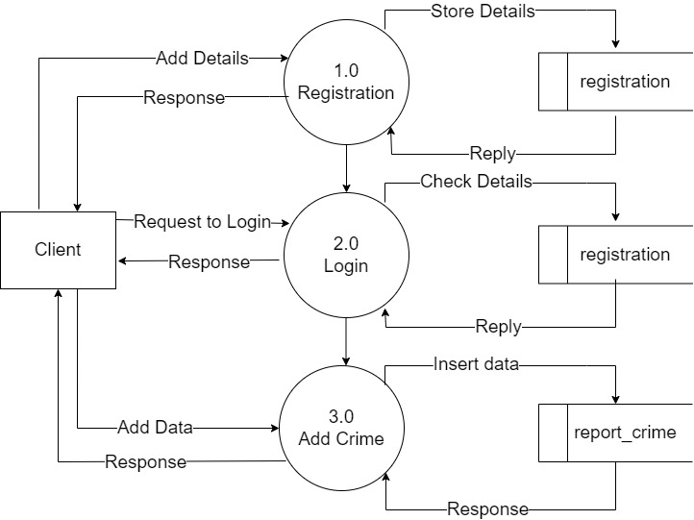
DFD(Data Flow Diagram) Client side
Level 1 DFD

Slide 19
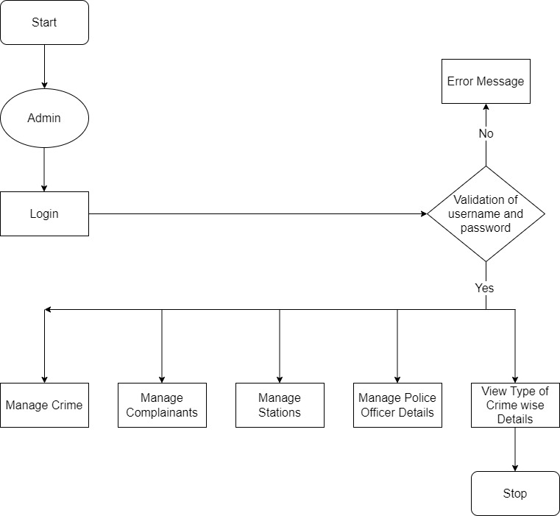
Flowchart(Admin)

Slide 20
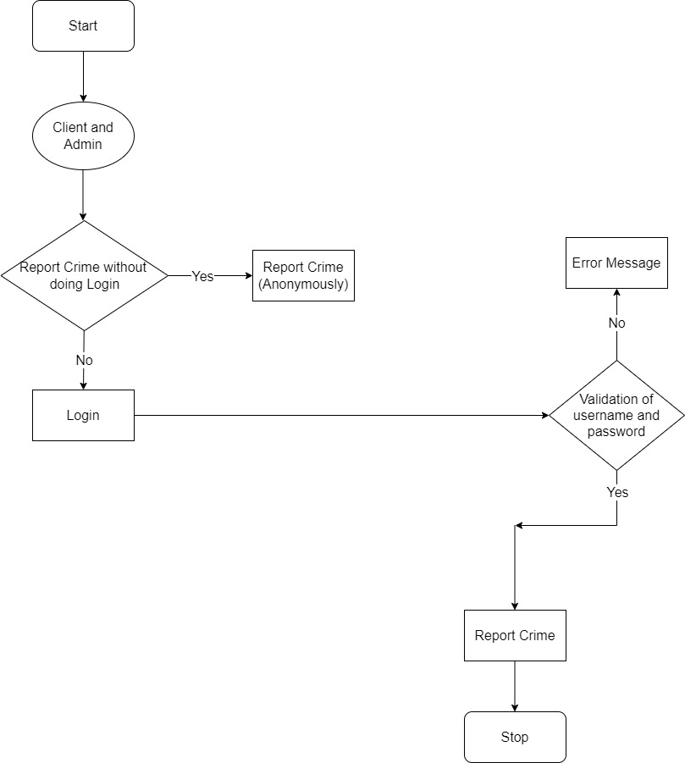
Flowchart(Client)

Slide 21
Database Layouts(Admin Module)
Registration
Report Crime
Complainants
Stations
Police Officer

Slide 22
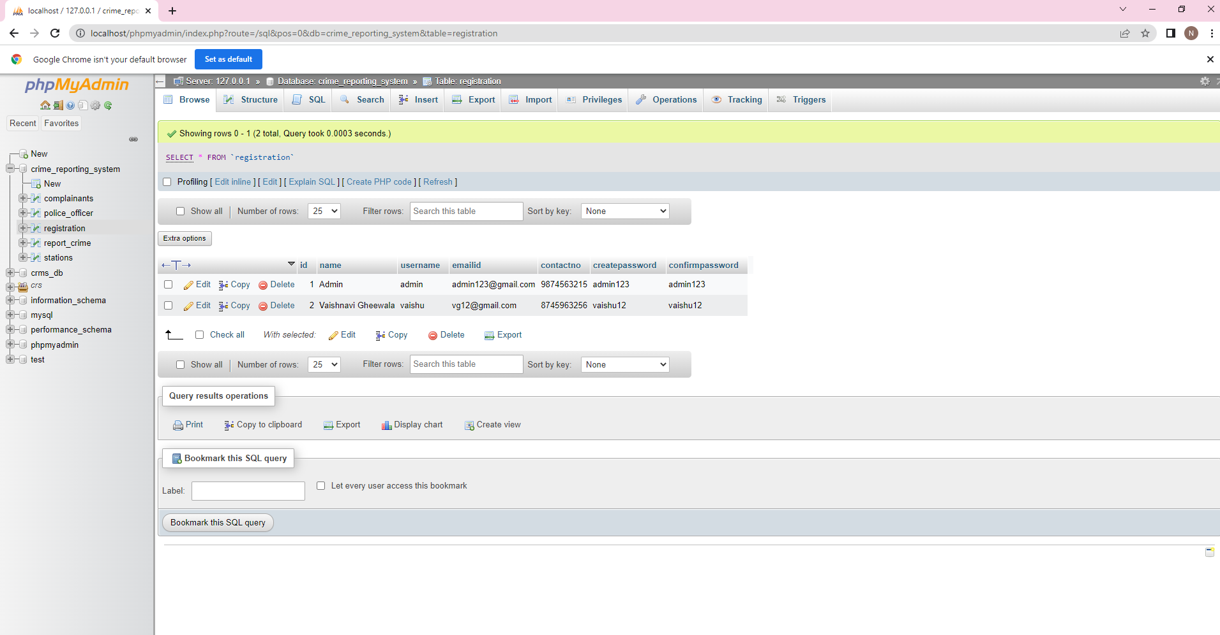
Registration Table

Slide 23
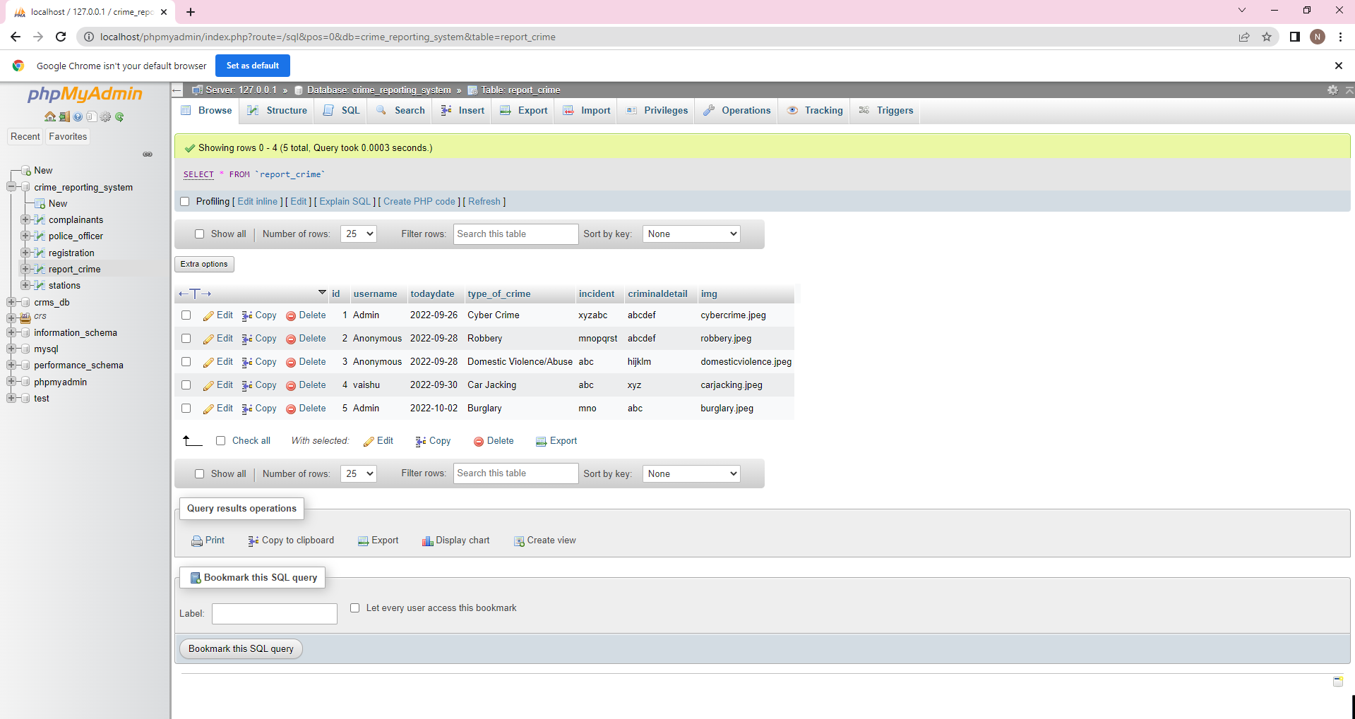
Report_crime Table

Slide 24
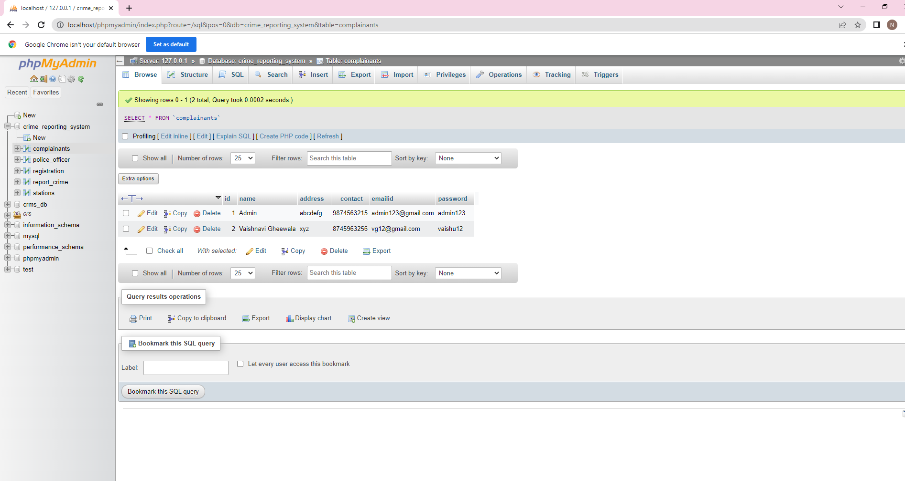
Complainants Table

Slide 25
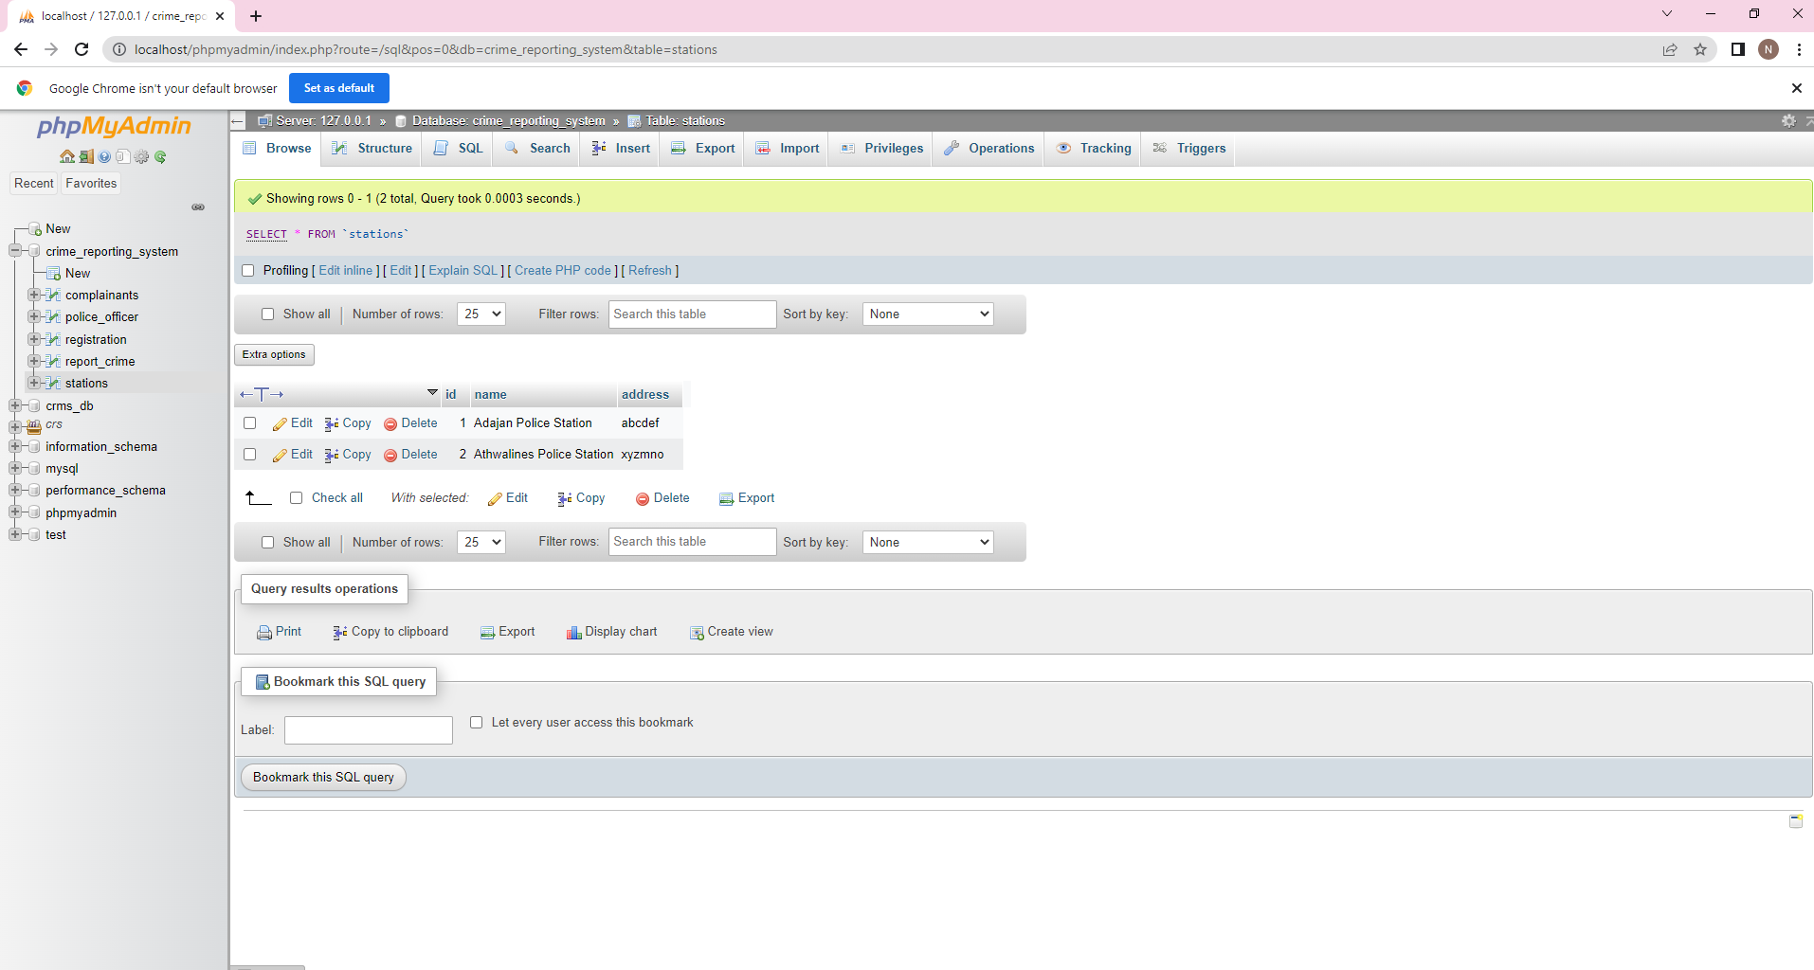
Stations Table

Slide 26
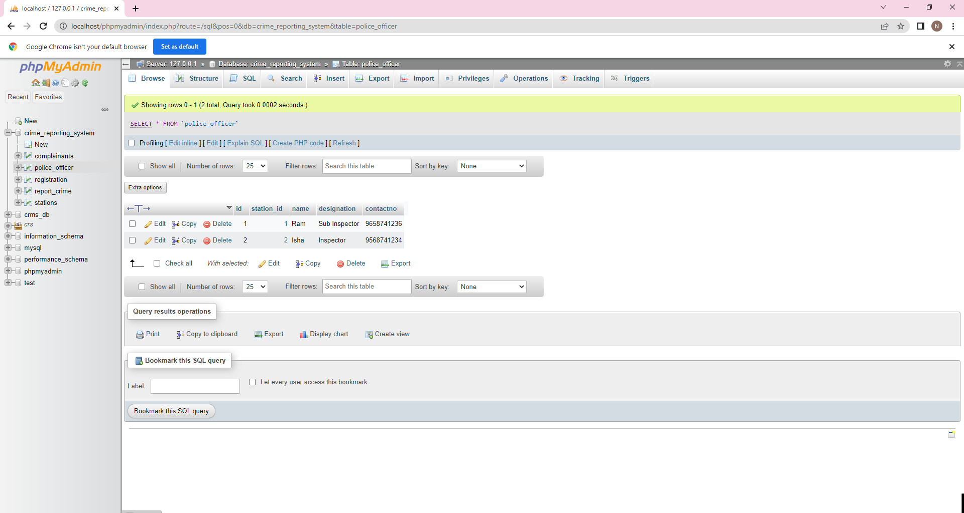
Police Officer Table

Slide 27
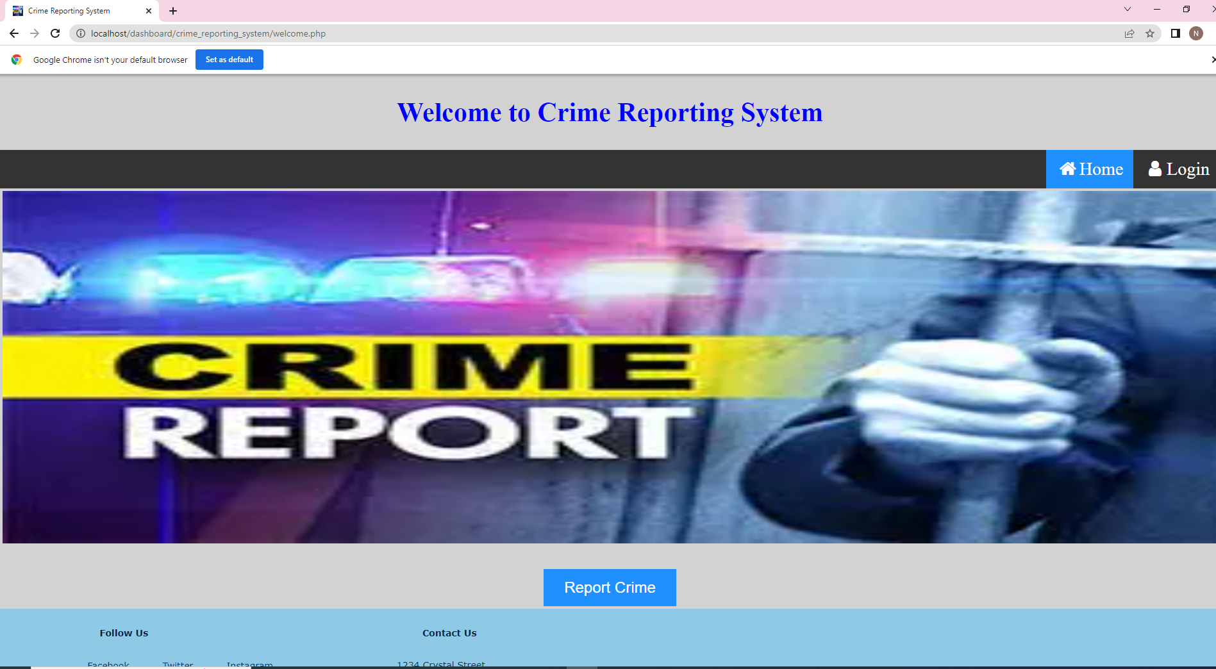
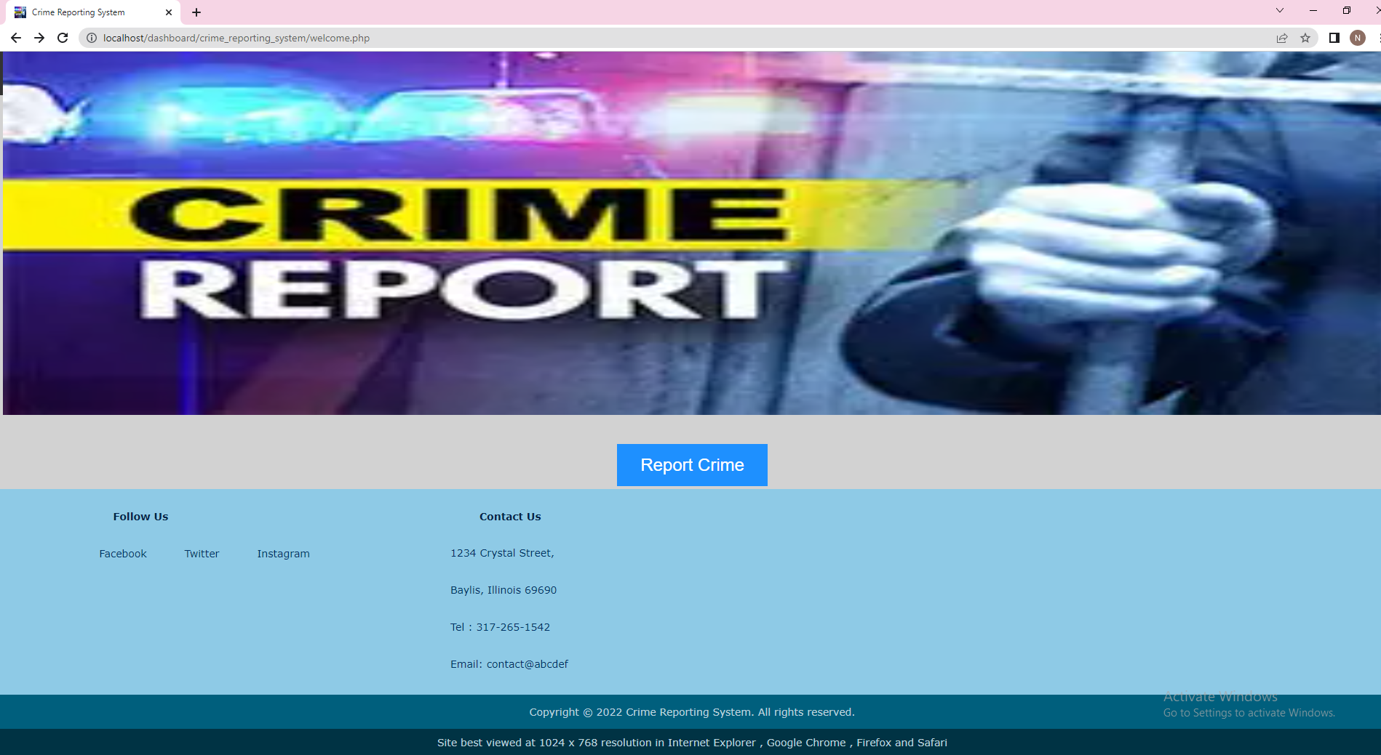
Screen Layout Index Page(Welcome Page):
Helps the Admin to login in to the admin modules and the client into its clients sided modules
First Page of Crime Reporting System.

Slide 28
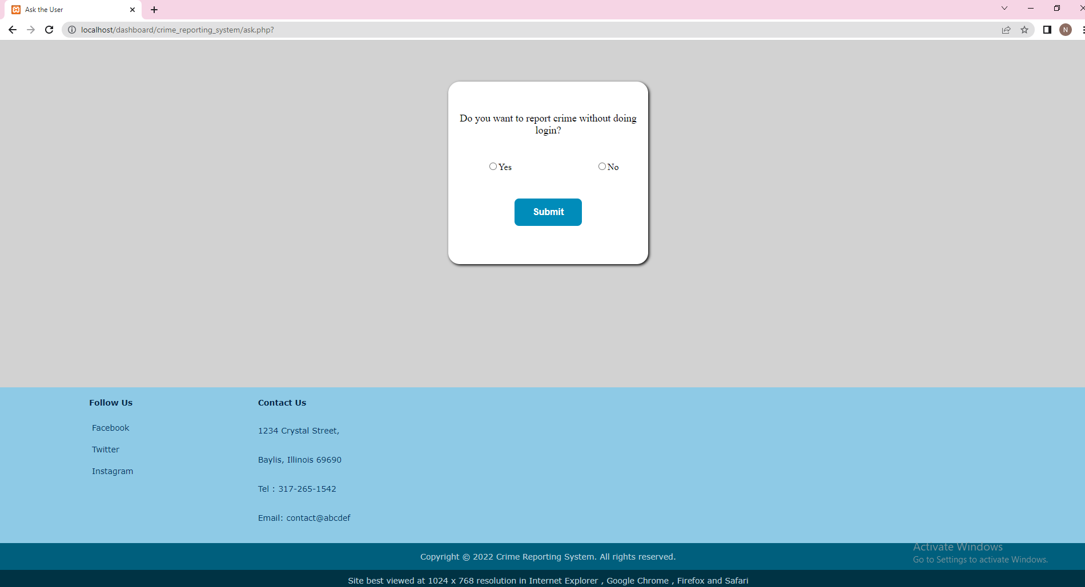
Ask Page for Client: Used to ask the client whether the client wants to login and register and then report the crime or want to report the crime without revealing the identity

Slide 29
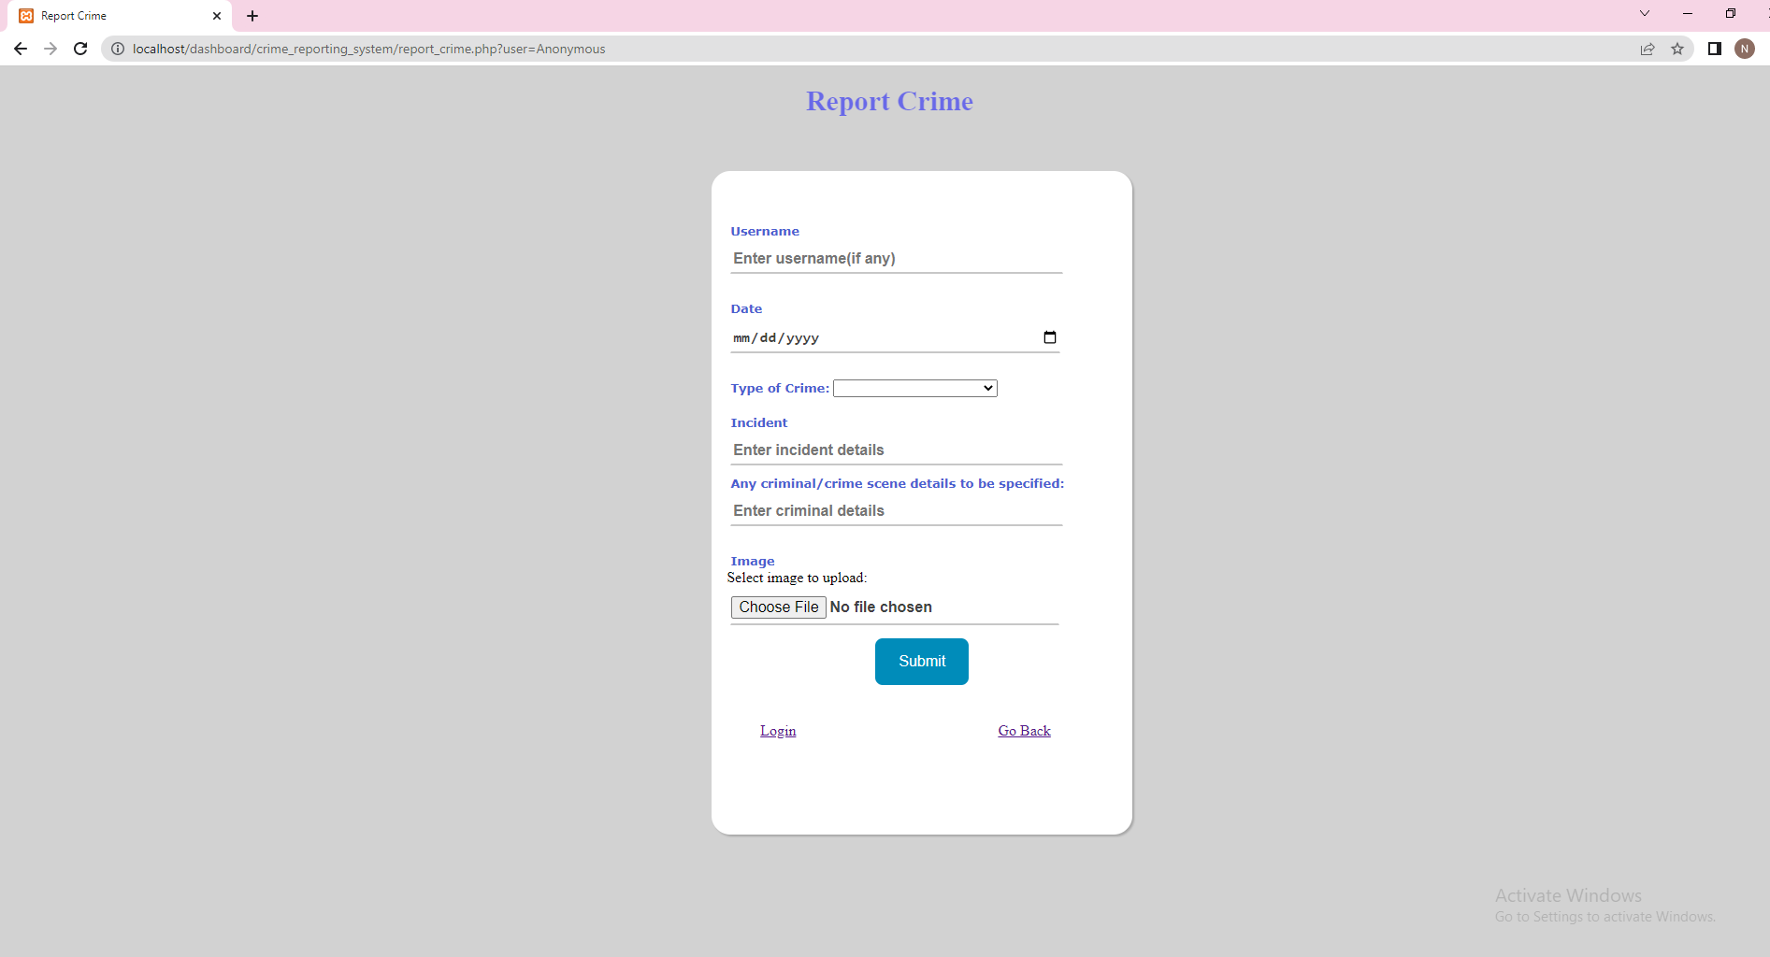
Report Crime Page for Client: If user selects yes in the ask page Used by clients or users to report the crime

Slide 30
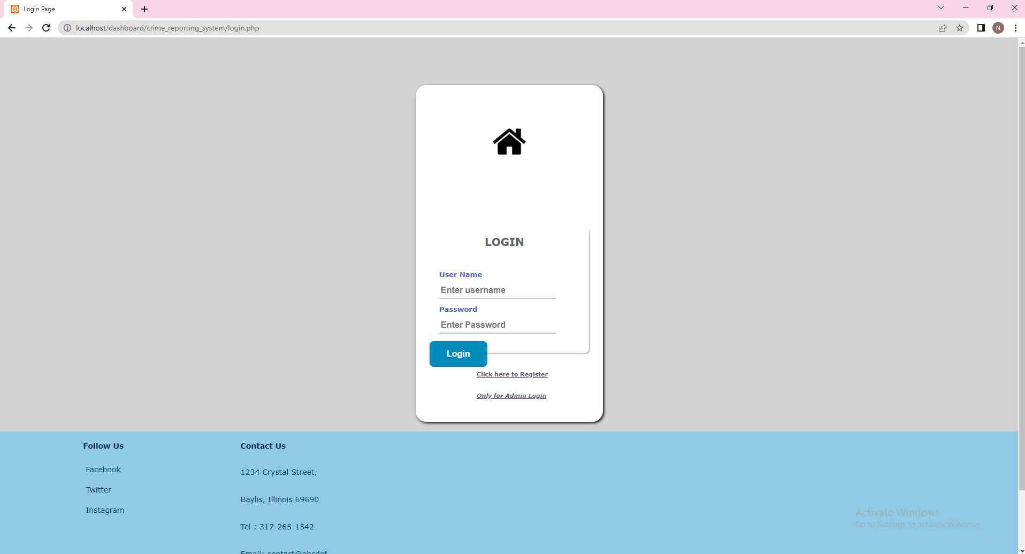
Login Page for Client:
If user selects no in the ask page
Used by clients or users to login in Crime Reporting System
Login is done using username and password of the client or user

Slide 31
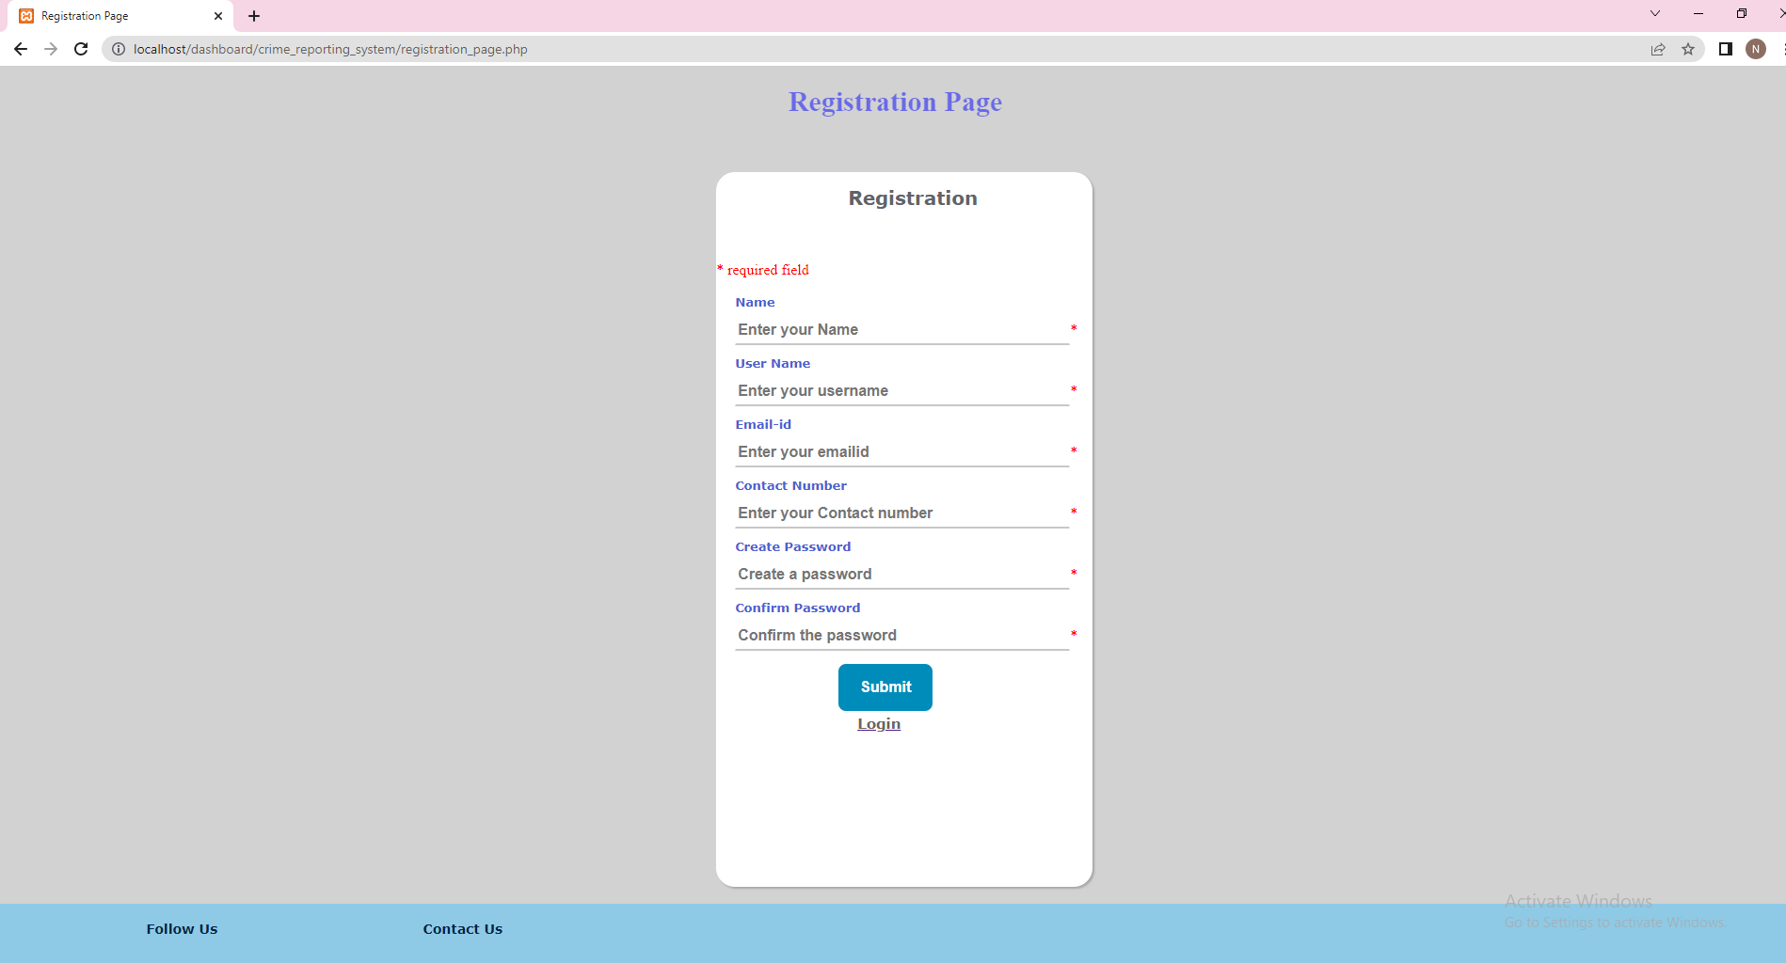
Registration Page for Client:
Used to add new clients
Login is done after the client registers

Slide 32
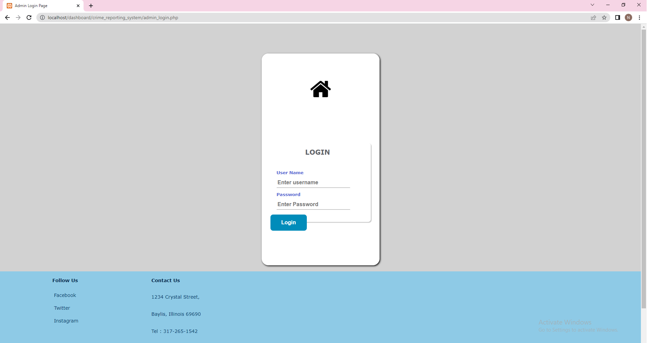
Login Page for Admin:
If user selects yes in the ask page
Used by admin to login in Crime Reporting System
Login is done using username and password of the admin

Slide 33
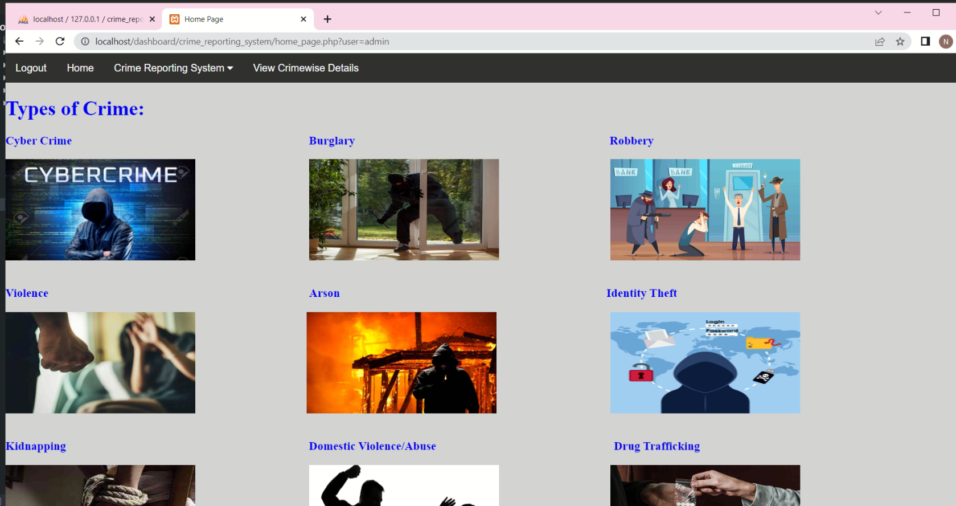
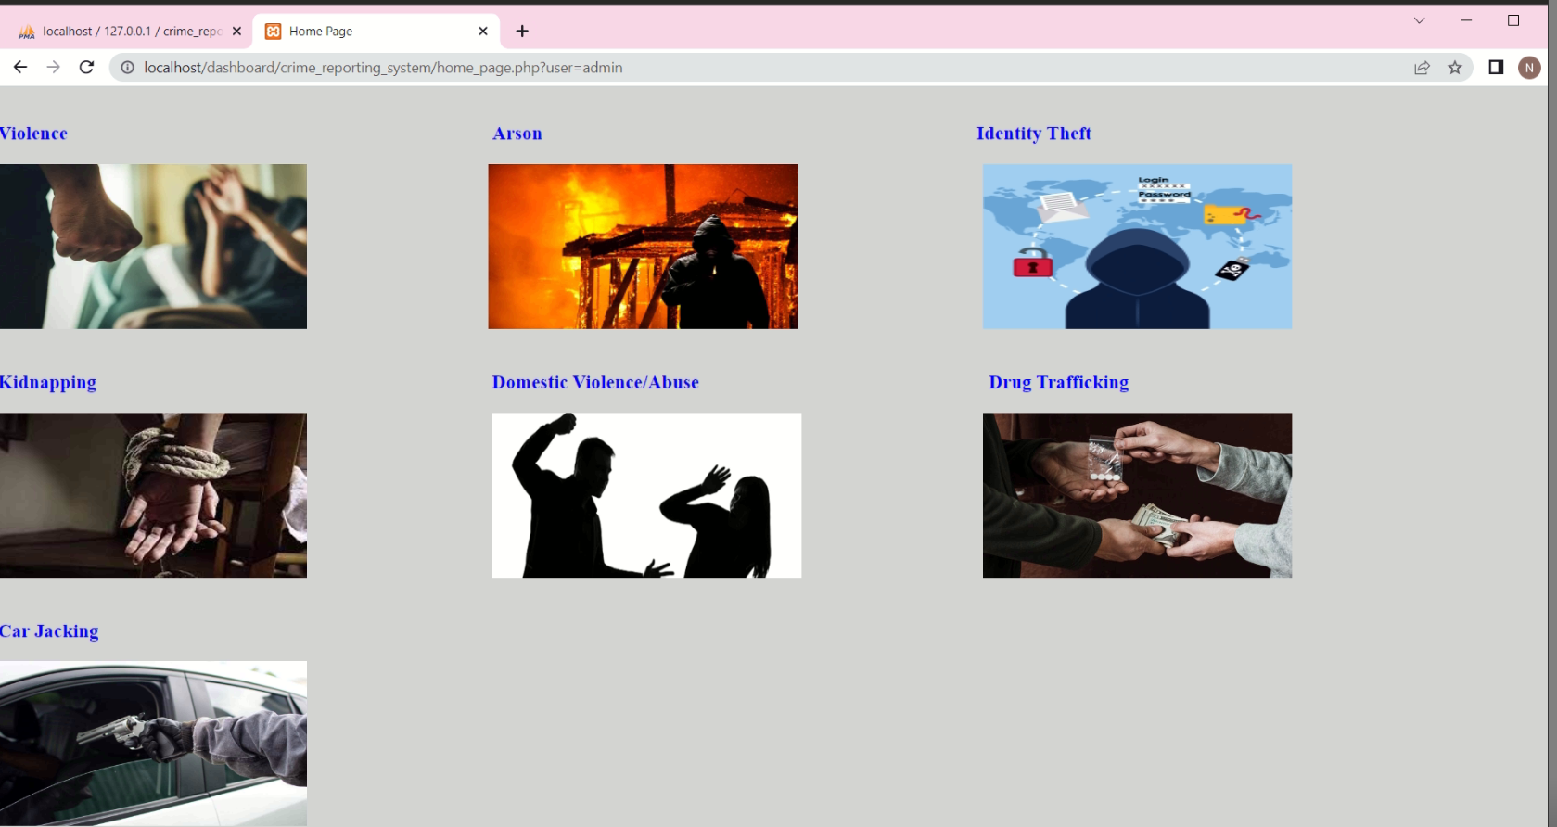
Home Page for Admin:
If Admin login is successful then Admin is redirected to home page

Slide 34
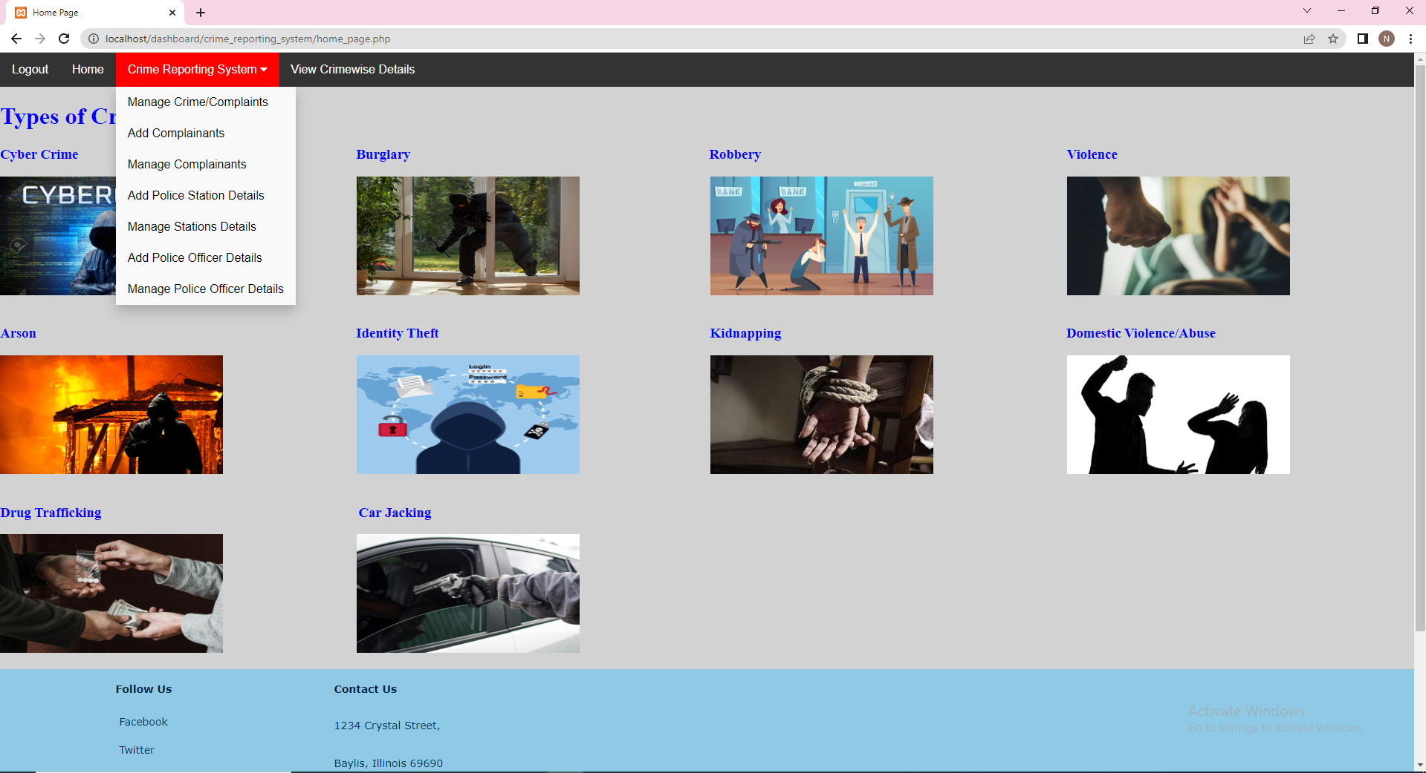
Topbar for admin:
Consists of various links to be redirected to other modules

Slide 35
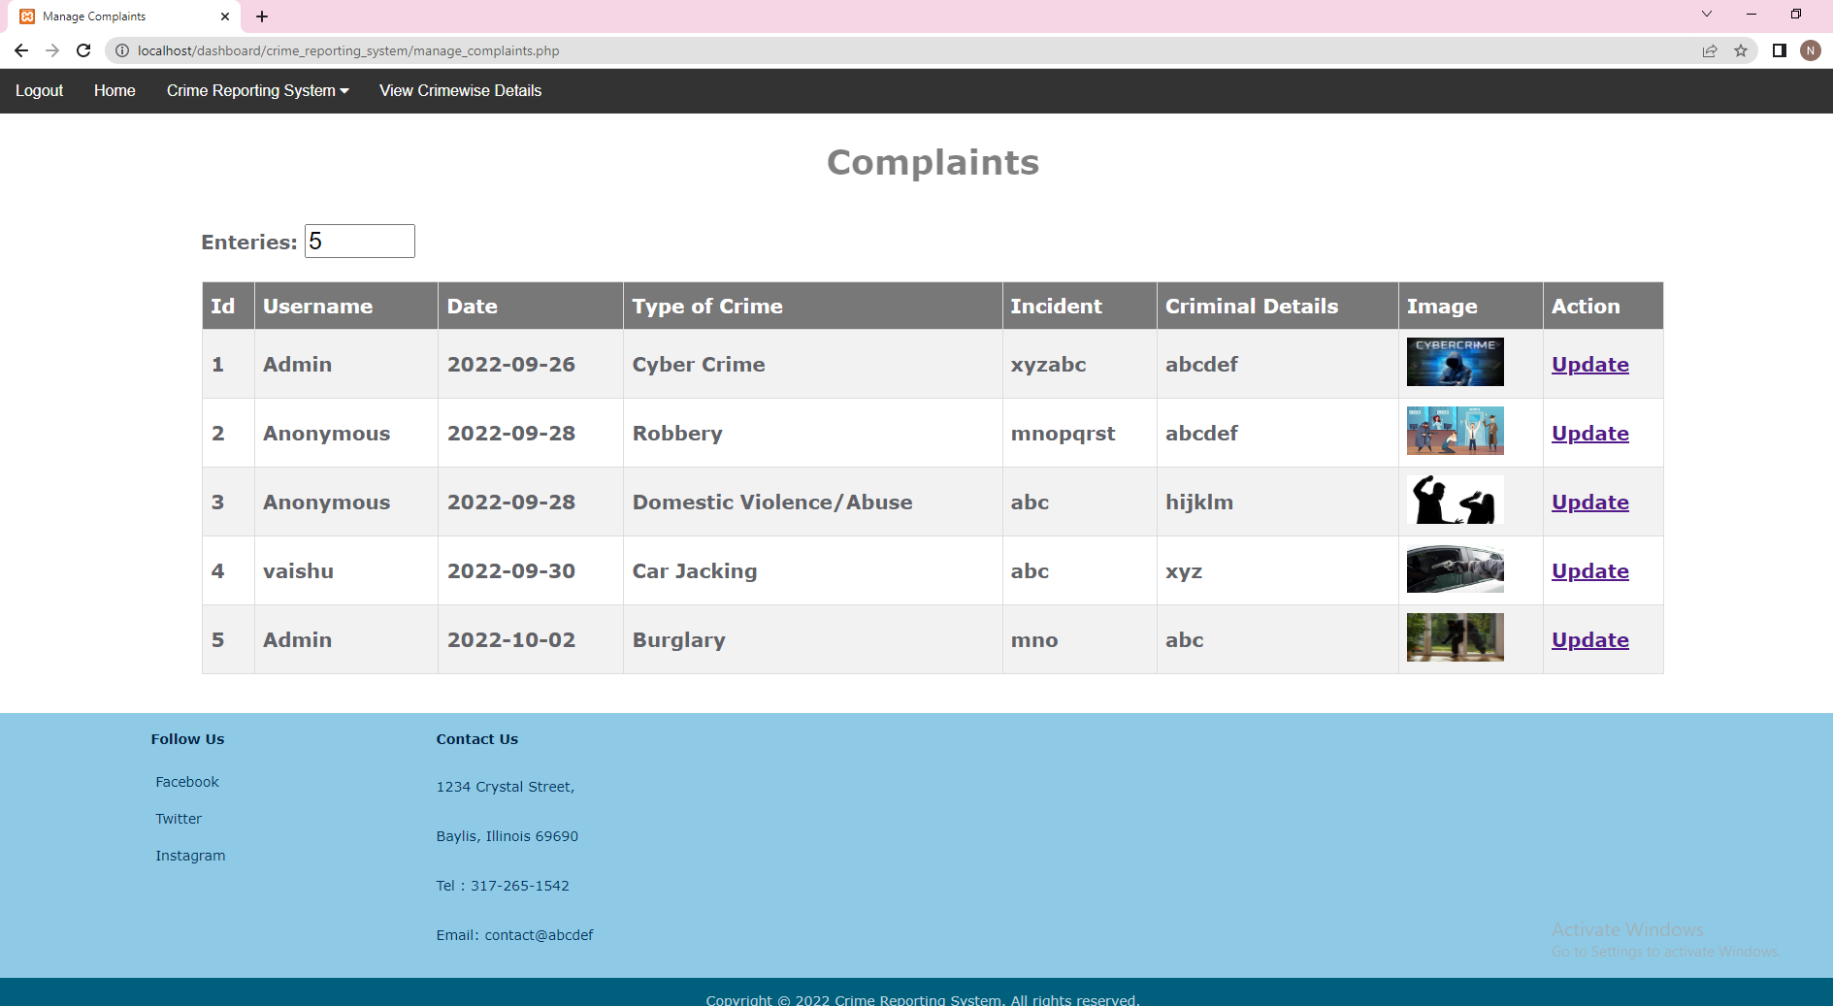
Manage crime page:
Admin can update the crime report by clicking on update hyperlink

Slide 36
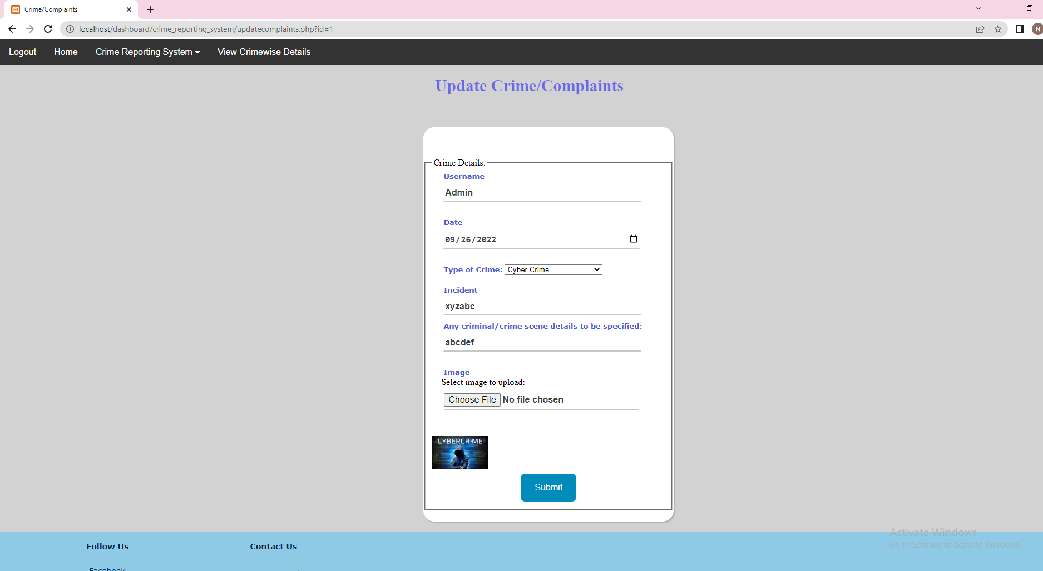
Update crime page:

Slide 37
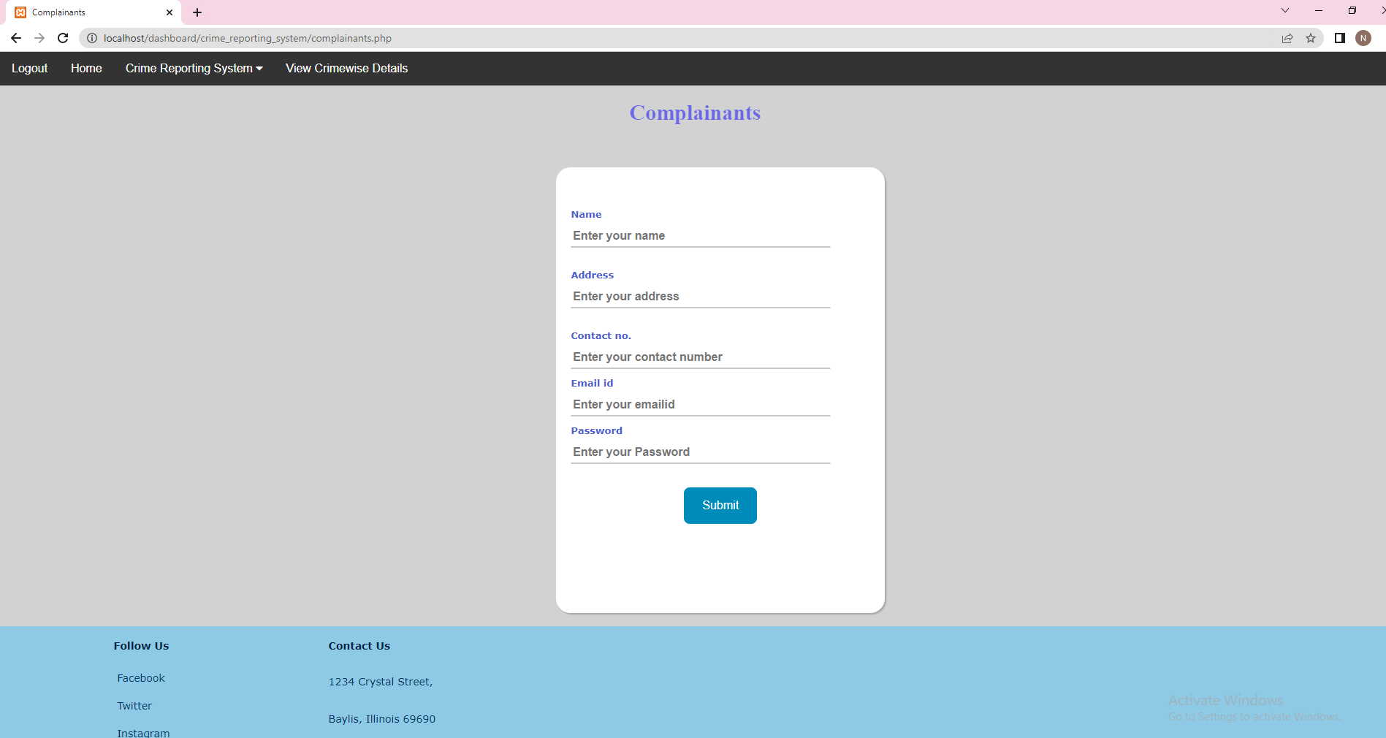
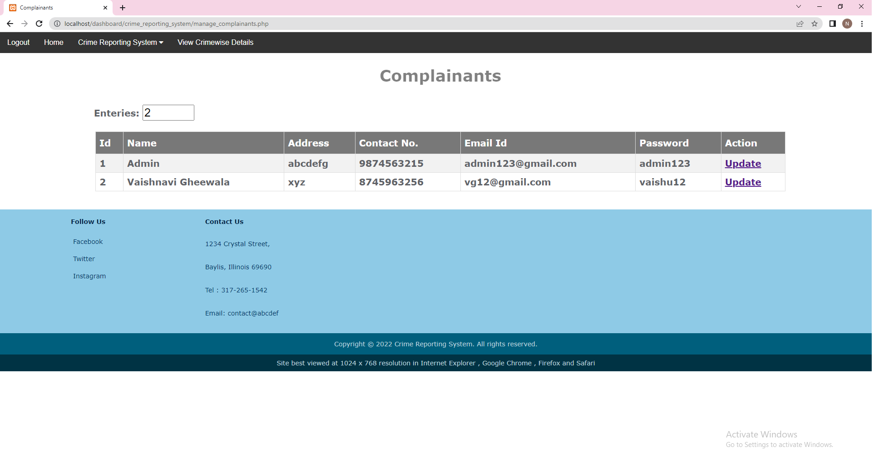
Complainants page:
Admin can add the complainants details and update them from manage complainants page by clicking on update hyperlink

Slide 38
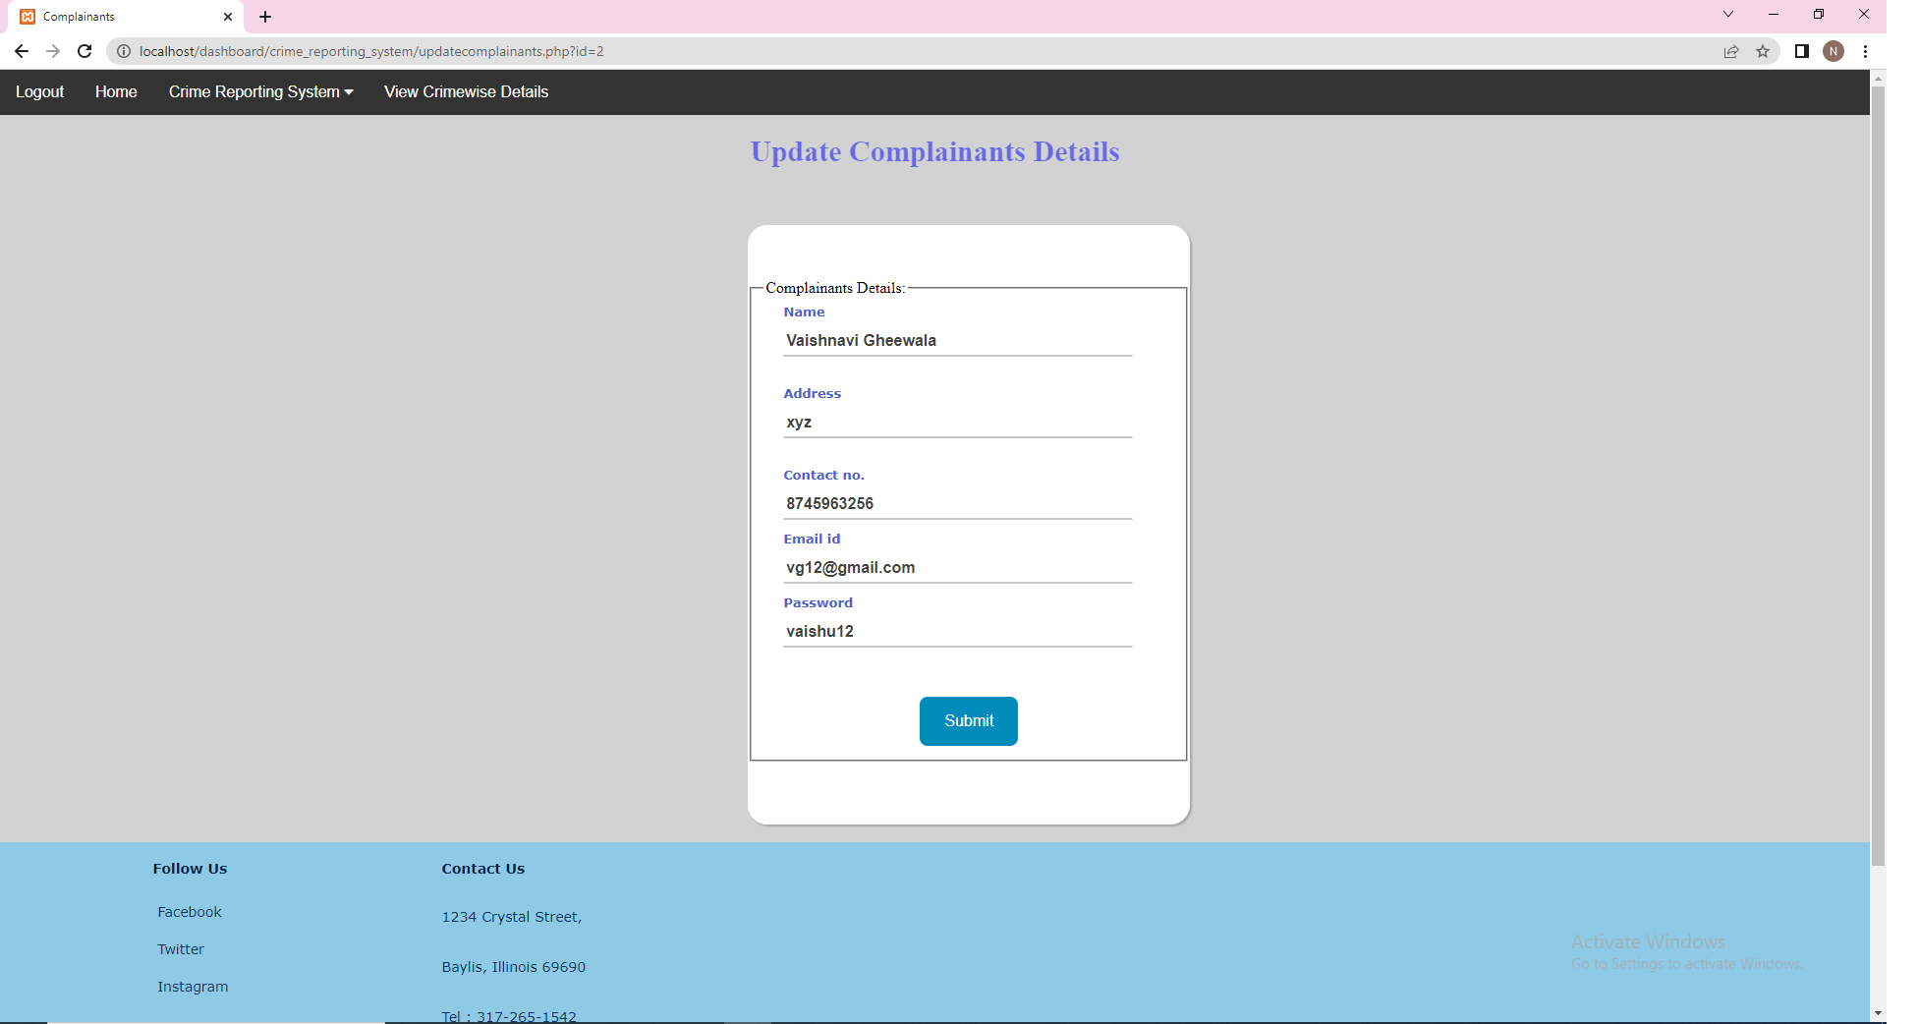
Update complainants page:

Slide 39
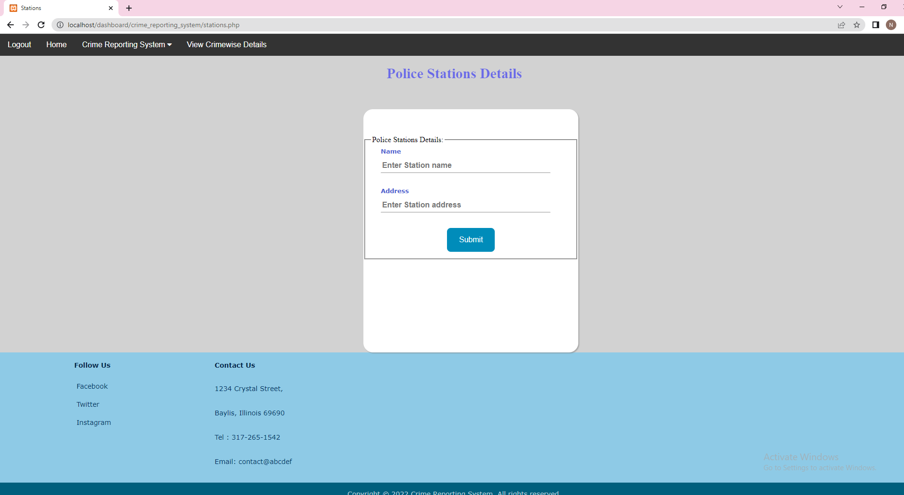
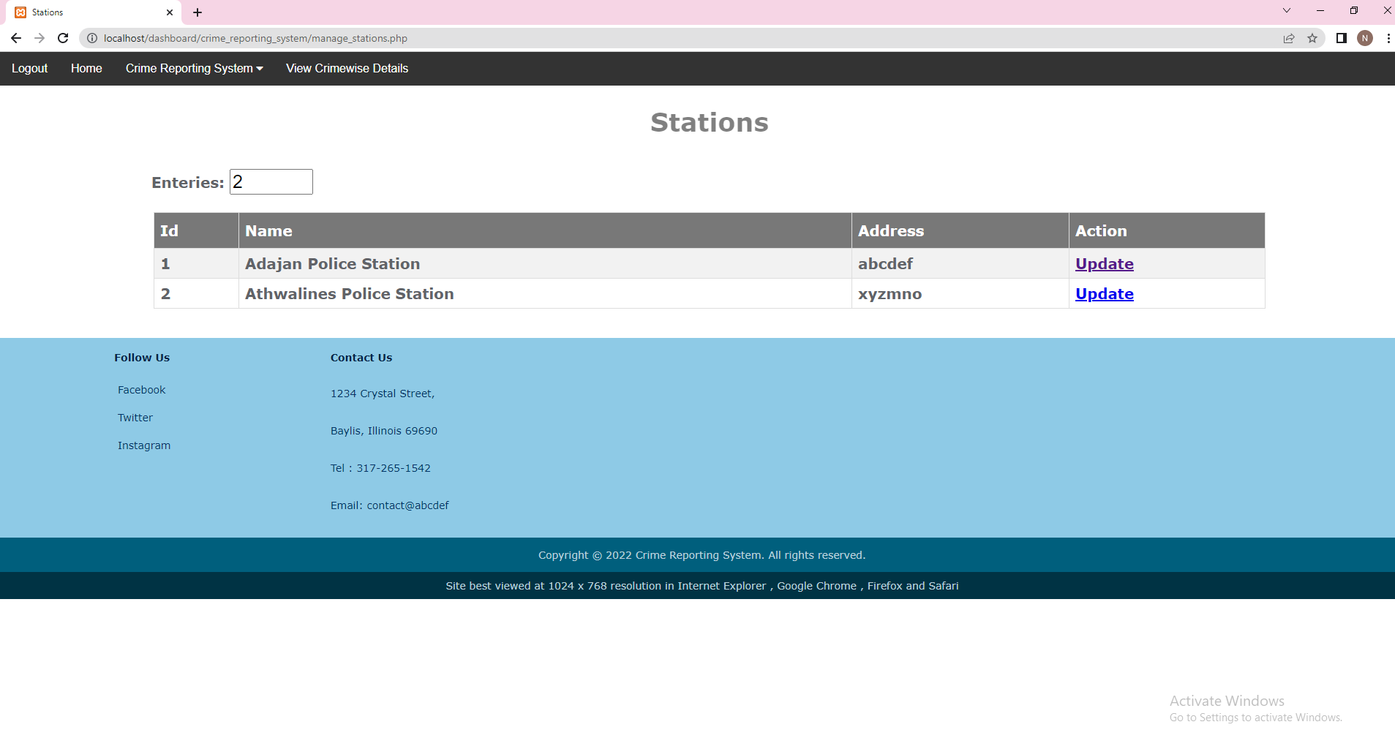
Stations page:
Admin can add the police stations details and update them from manage stations page by clicking on update hyperlink

Slide 40
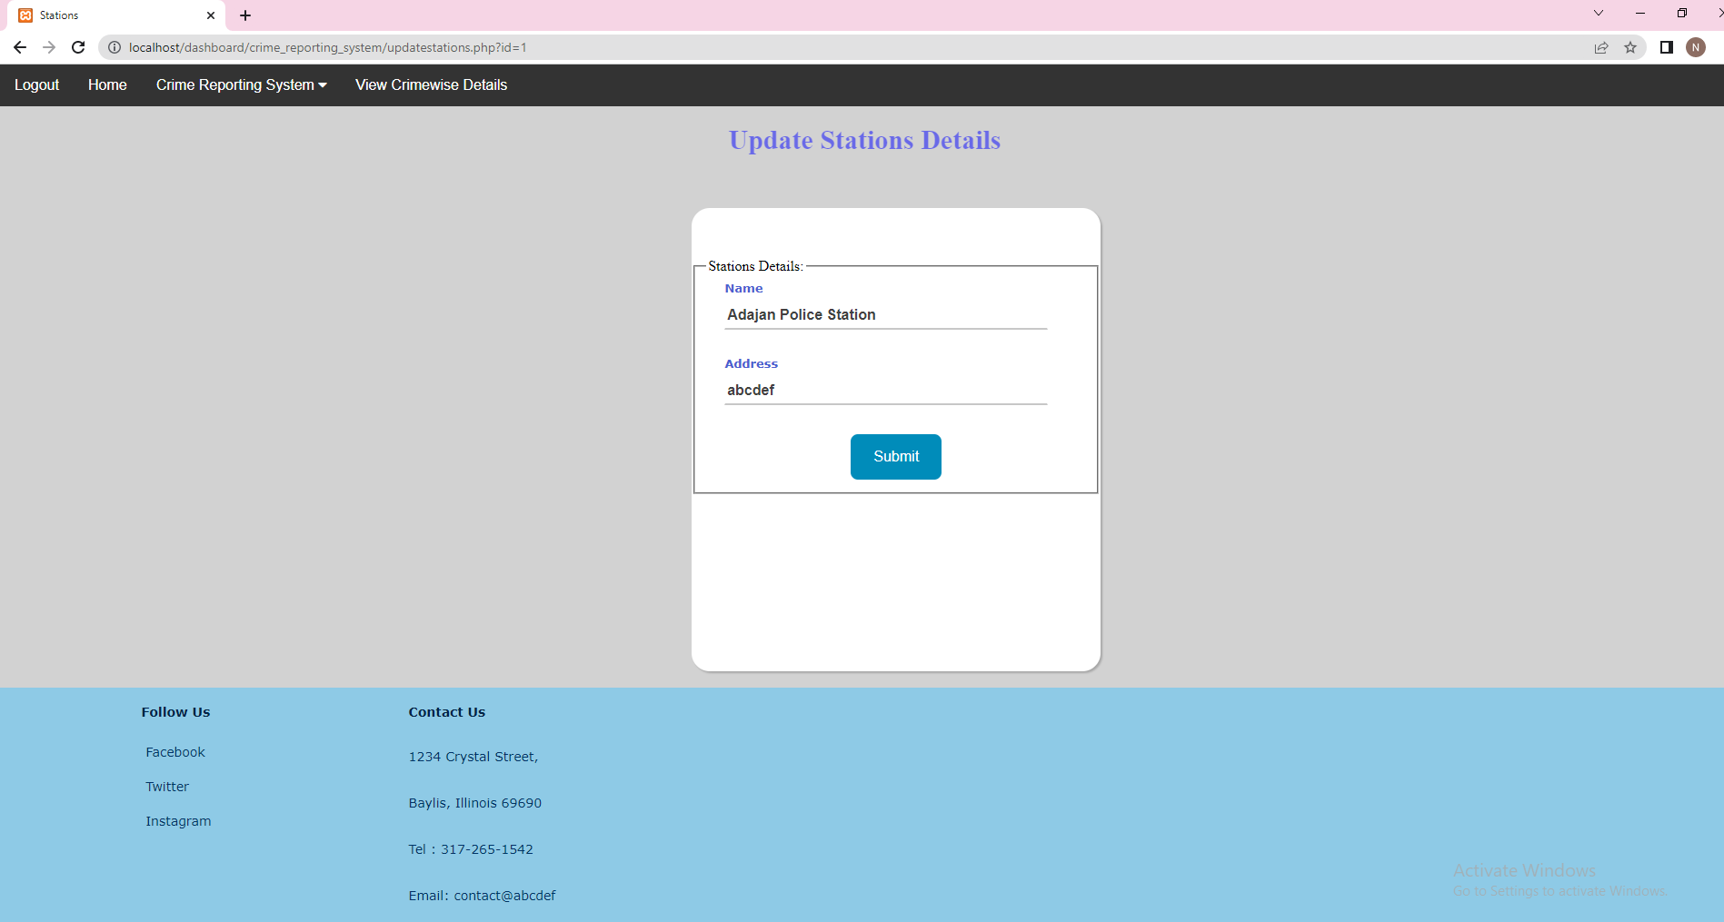
Update stations page:

Slide 41
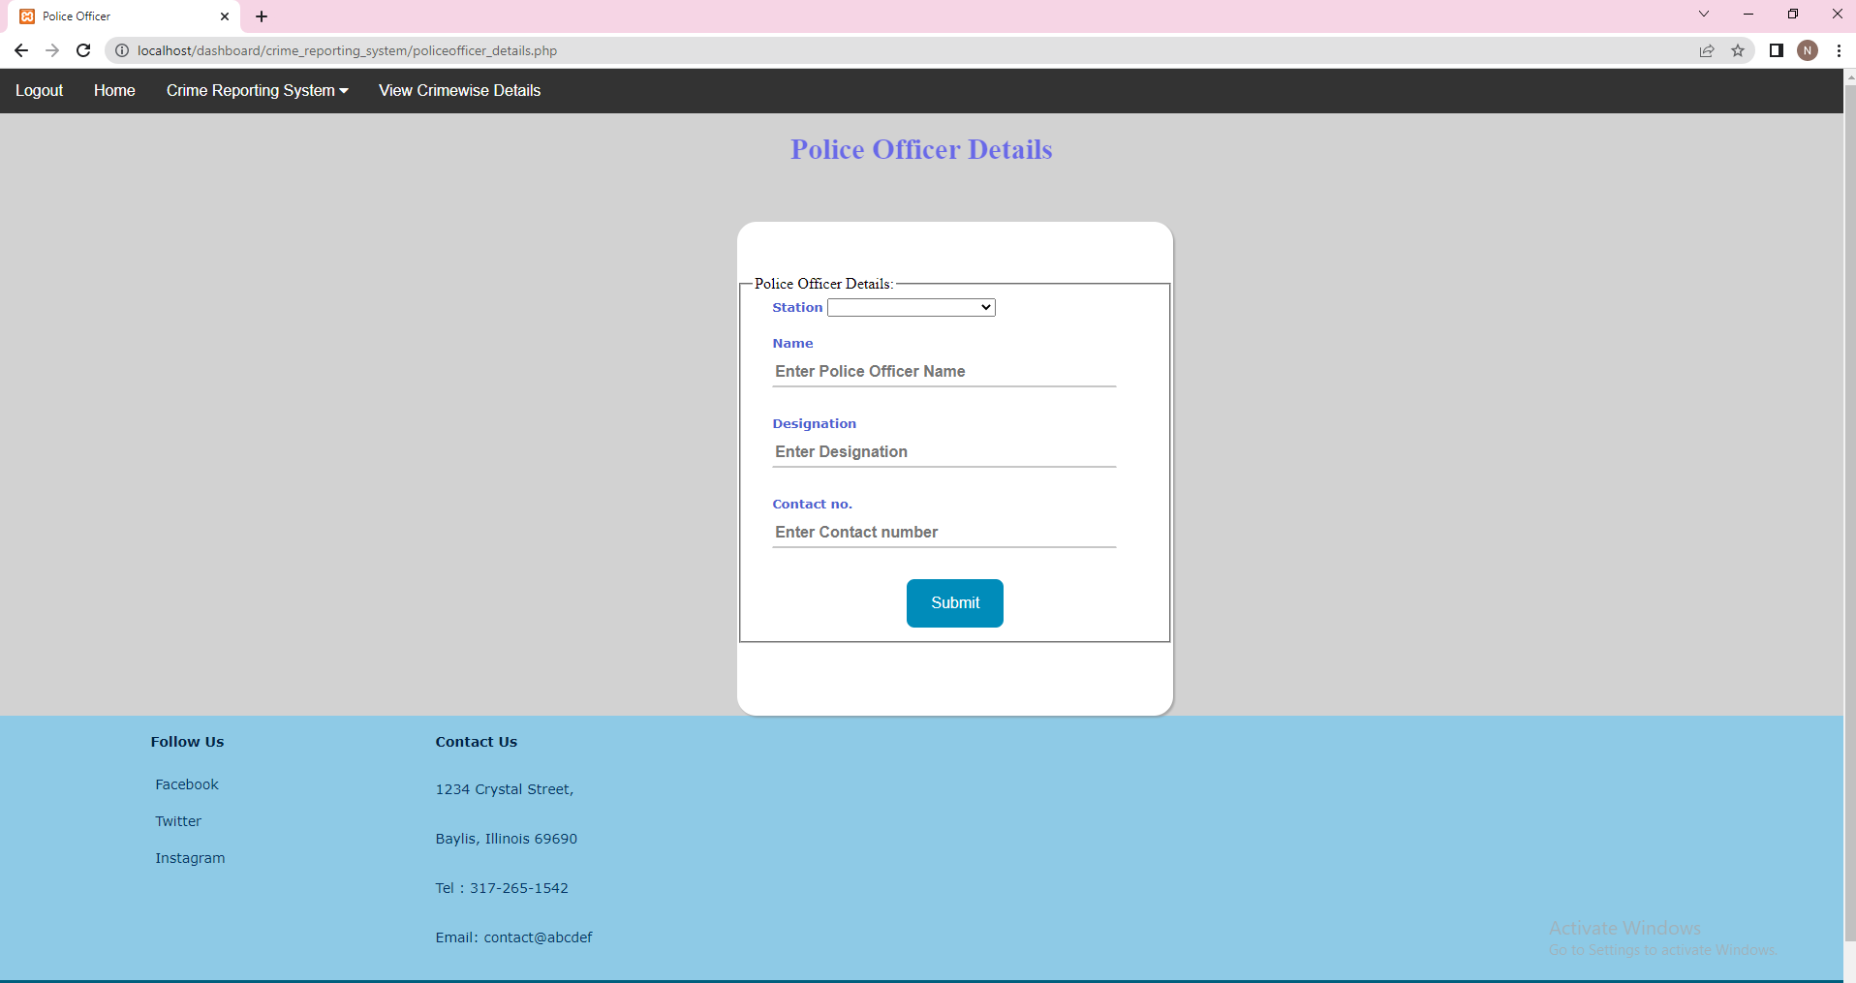
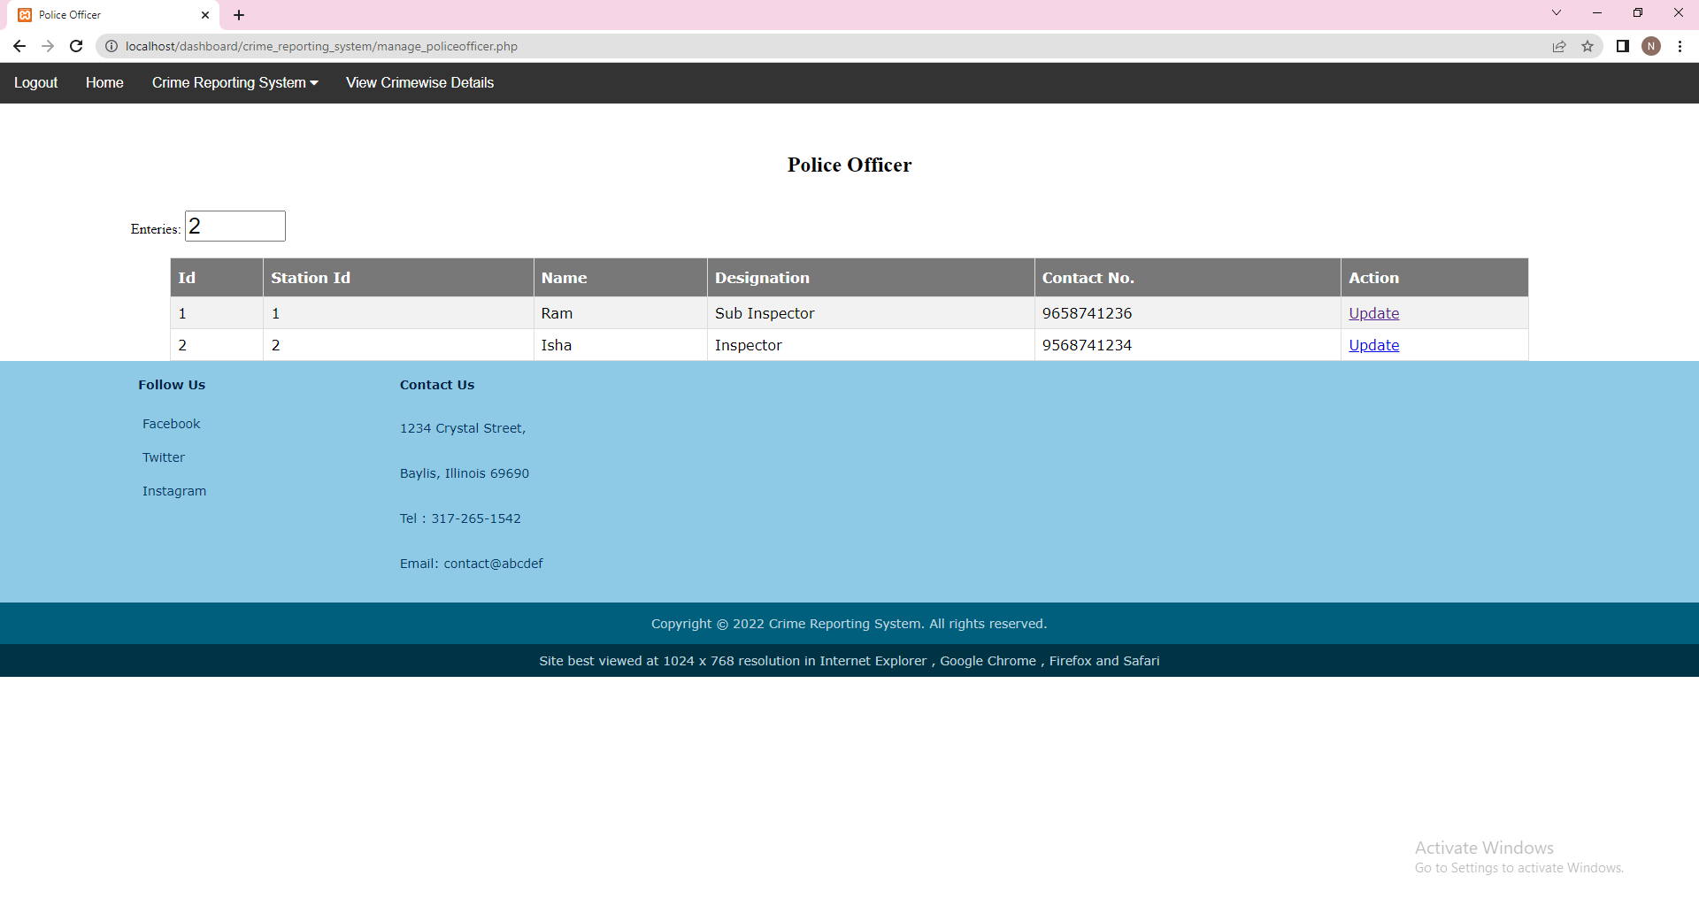
Police officer page:
Admin can add the police officer details and update them from manage police officer page by clicking on update hyperlink

Slide 42
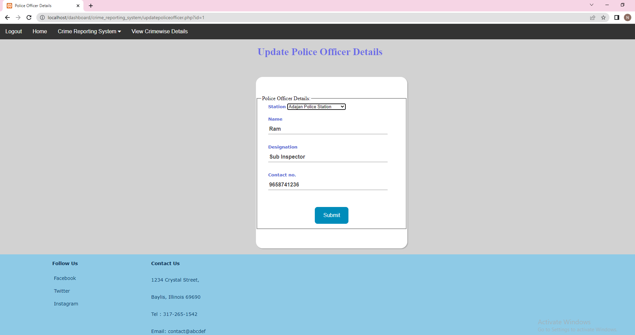
Update police officer page:

Slide 43
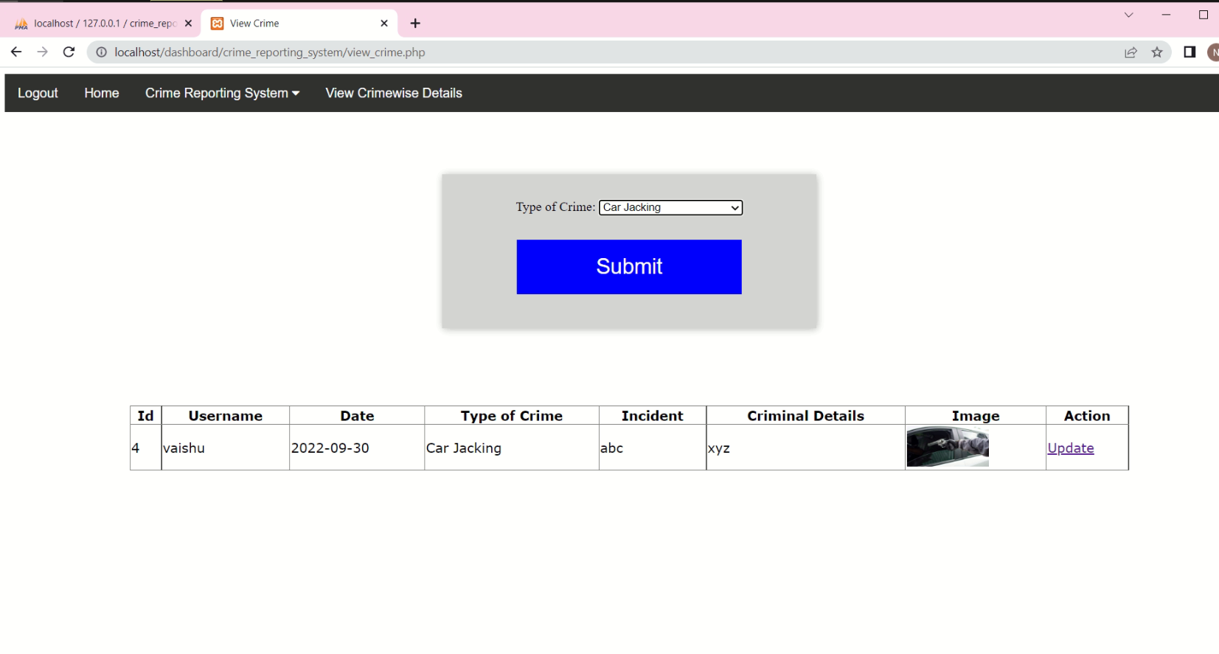
View crime page:
Admin can view the crime details by selecting th type of crime and update them from manage complaints page by clicking on update hyperlink

Slide 44
Thank You

